Slide 1

Advanced Supervised Learning GLM and AutoML
Varadharajan Suresh
vs2769

Slide 2

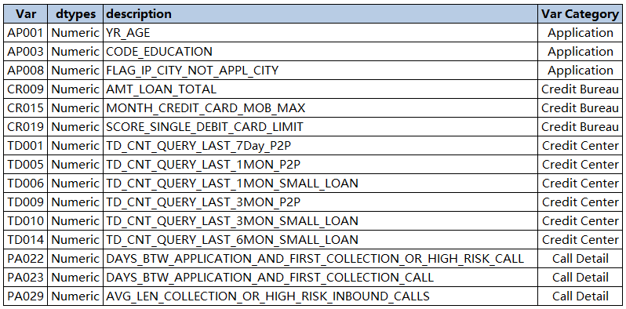

EDA
Data Dictionary
Newly created features
AP001_D_WOE, AP003_D_WOE, AP008_D_WOE, CR009_D_WOE, CR015_D_WOE,CR019_D_WOE, PA022_D_WOE, PA023_D_WOE, PA029_D_WOE,TD001_D_WOE, TD005_D_WOE, TD006_D_WOE, TD009_D_WOE,TD010_D_WOE, TD014_D_WOE

Slide 3
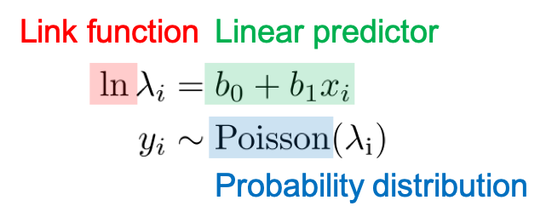
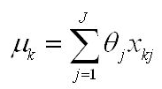
Modeling GLM
H2O is an opensource machine learning platform that facilitates you to build models based on data that you have.
What is GLM?
A generalized linear model (GLM) is a flexible generalization of ordinary linear regression. The GLM generalizes linear regression by allowing the linear model to be related to the response variable via a link function and by allowing the magnitude of the variance of each measurement to be a function of its predicted value.
There are three components in generalized linear models.
Linear predictor is just a linear combination of parameter (b) and explanatory variable (x).
Link function literally “links” the linear predictor and the parameter for probability distribution.
Probability distribution which generates the observed variable y.
Gaussian Link Equatoin

Slide 4
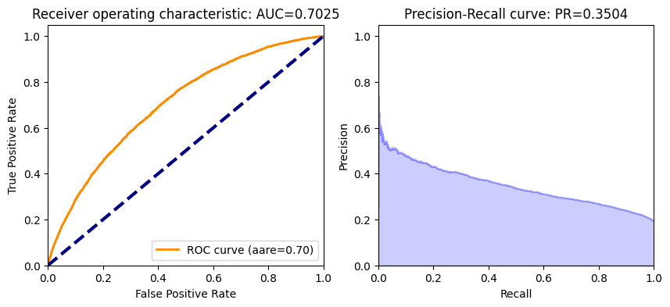
Modeling GLM
glm_v5 = H2OGeneralizedLinearEstimator(
family= "AUTO",
alpha = 0.02 ,
lambda_ = 5e-7)
glm_v5.train(
predictors,
target,
training_frame=train_hex)
Family: The family option specifies a probability distribution from an exponential family. You can specify one based on the response column type
Alpha: Distribution of regularization between the L1 (Lasso) and L2 (Ridge) penalties. A value of 1 for alpha represents Lasso regression, a value of 0 produces Ridge regression, and anything in between specifies the amount of mixing between the two. Default value of alpha is 0 when SOLVER = ‘L-BFGS’; 0.5 otherwise.
Lambda: Regularization strength

Slide 5

Modeling AUTOML
H2O’s AutoML can be used for automating the machine learning workflow, which includes automatic training and tuning of many models within a user-specified time-limit.
H2O offers a number of model explainability methods that apply to AutoML objects (groups of models), as well as individual models (e.g. leader model). Explanations can be generated automatically with a single function call, providing a simple interface to exploring and explaining the AutoML models.

Slide 6

Modeling AUTOML
aml_v0 = H2OAutoML(max_runtime_secs = 120, max_models=20,
nfolds = 25,
seed=414,
balance_classes=True, keep_cross_validation_predictions=True, keep_cross_validation_models=True) aml_v0.train(predictors,target,training_frame=train_hex)
max_runtime_secs: Specify the maximum time that the AutoML process will run for.
max_models: Specify the maximum number of models to build in an AutoML run, excluding the Stacked Ensemble models.
Nfolds: Number of folds for k-fold cross-validation.
Seed: Set a seed for reproducibility.
balance_classes: Specify whether to oversample the minority classes to balance the class distribution. This option can increase the data frame size.
keep_cross_validation_predictions: Whether to keep the predictions of the cross-validation predictions.
keep_cross_validation_models: Whether to keep the cross-validated models.

Slide 7
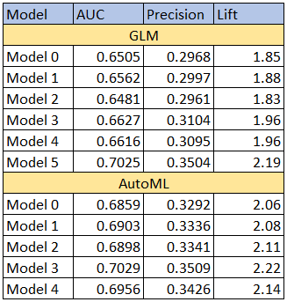
Summary
Highlights
GLM: best performing model was model 5 which has the AUC of 0.7025, Precision of 0.3504 and lift of 2.19. The best values were alpha = 0.02 and Lambda = 5e-7
AutoML: best performing model was model 3 which has the AUC of 0.7029, Precision of 0.3509 and lift of 2.22.

Slide 8
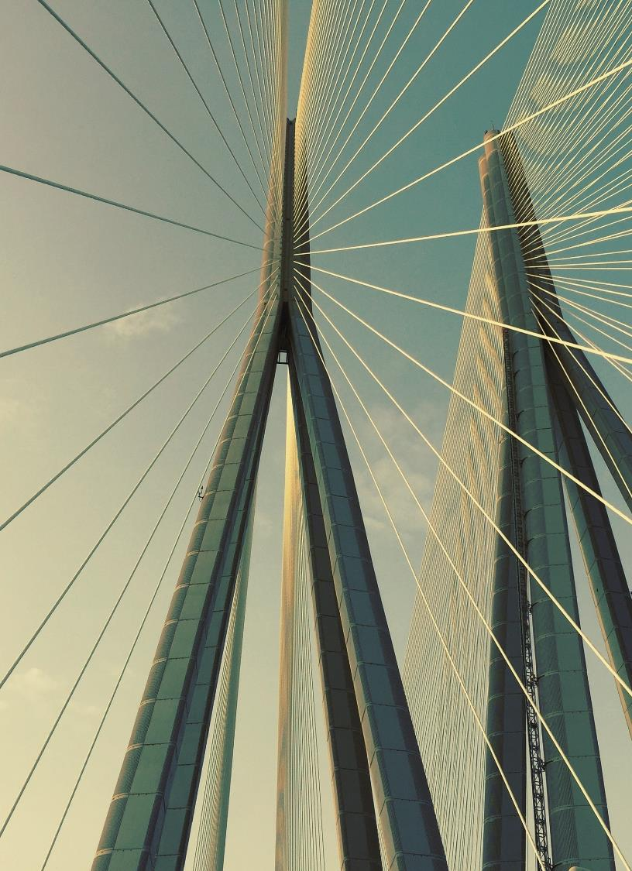

Thank you

